Slide 1
Optimizing Matrix Normalization with High-Level Synthesis (HLS)
Algorithm overview and pragma-driven hardware optimization

Slide 2
High-Level Algorithm Functionality
• Step 1: Row Normalization: Iterates through each row, calculates the sum, and divides each element by (row_sum + 1.0).
• Step 2: Column Accumulation: Maintains a running sum of each column.
• Step 3: Calculate Scales: Averages the column sums by dividing each by N_ROWS.
• Step 4: Final Scaling & Store: Multiplies intermediate values by scales and writes to C_DRAM.

Slide 3
Hardware Optimization Methods
• 512-bit Vectorization: Groups 16x 32-bit data elements into a single 512-bit bus word to saturate DRAM bandwidth.
• Ping-Pong Buffering (A_buf): Double-buffer approach hides memory access latency by computing row i while loading row i+1.
• Manual Bit-Packing/Unpacking: Uses ap_int<32> to manually extract and pack 24-bit custom data types into 512-bit transfers.

Slide 4
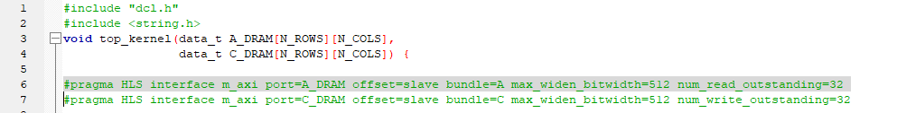
Maximizing AXI Bandwidth
• m_axi: Generates an AXI4 memory-mapped interface for DRAM.
• max_widen_bitwidth=512: Automatically widens the data port to fetch 16 elements per clock cycle.
• num_outstanding: Allows hardware to issue up to 32 read/write requests ahead of time to prevent pipeline stalls.

Slide 5
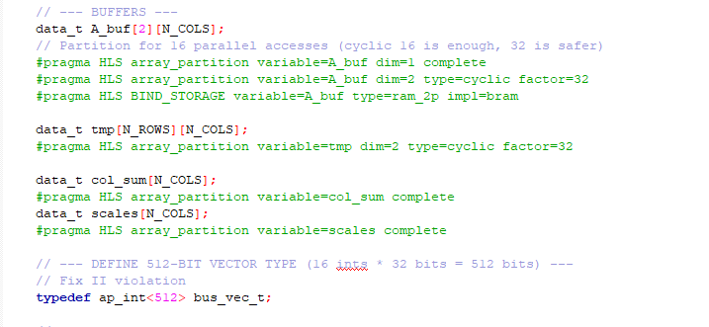
Removing BRAM Bottlenecks
array_partition complete: Shatters the array into individual registers for simultaneous read/write access.
•array_partition cyclic factor=32: Partitions memory cyclically across 32 RAM banks so the compute loop can access up to 32 elements in parallel.
•BIND_STORAGE: Forces the buffer to use True Dual-Port BRAM for predictable routing.

Slide 6
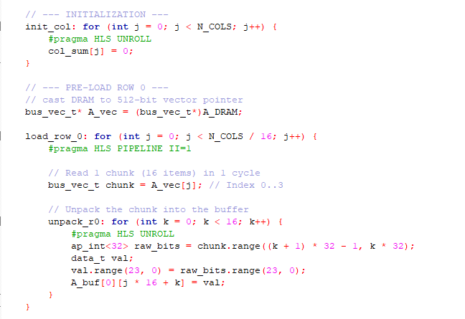
Pipelining and Unrolling

Slide 7
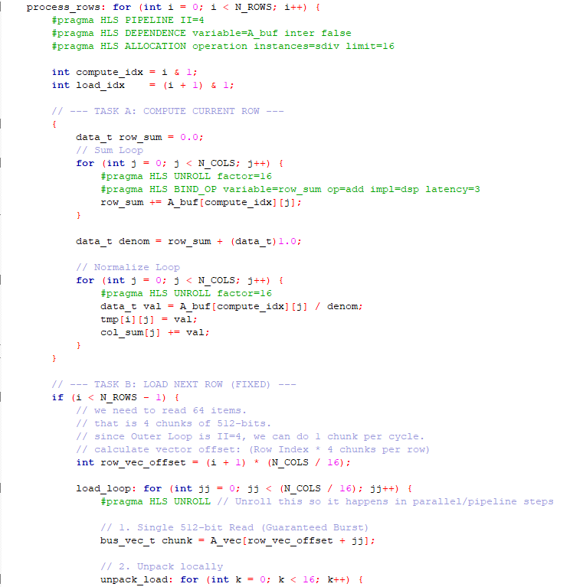
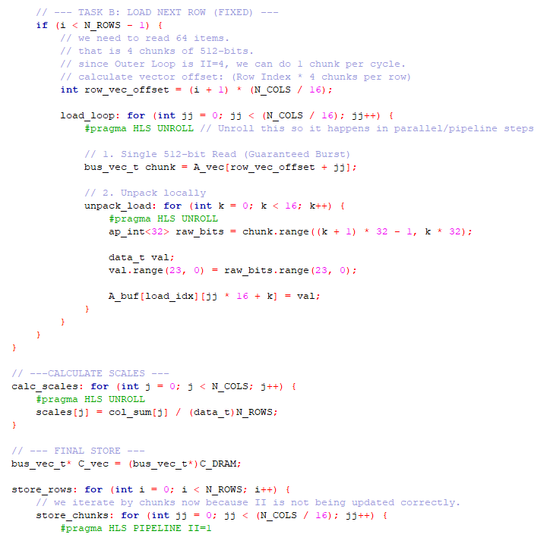

Slide 8
Deep Dive: The Ping-Pong Buffer
Hiding Memory Latency with Double Buffering
• The Problem: Reading from DRAM is slow; waiting for loads causes hardware stalls.
• The Solution: A_buf[2][N_COLS] acts as two separate memory banks.
• How it Works: A bitwise AND operator toggles indices. Compute engine crunches Row i in Bank 0 while memory interface loads Row i+1 into Bank 1.
• The Result: Memory transfer time is completely hidden behind computation time.

Slide 9
Deep Dive: Manual Bit-Packing & Unpacking
Saturating the AXI Bus via Bit Manipulation
• The Problem: AXI bus is 512 bits wide. Reading one variable per cycle wastes >90% of bandwidth.
• The Solution: bus_vec_t grabs a chunk of 16 data points in a single memory burst.
• Unpacking: Uses ap_int .range() to slice the 512-bit chunk into 32-bit segments, extracting only the necessary 24 bits.
• The Result: Acts like a highly efficient shipping container to keep compute engines fully fed.

